Slide 1
Register File Synthesis in ASIP Design
Manoj Kumar Jain
Nov 20, 2000

Slide 2
Increased interest in Application Specific Instruction Set Processors (ASIPs) Design
ASIPs are balance between
ASICs and General Programmable Processors
Recent Survey on ASIP Design

Slide 3
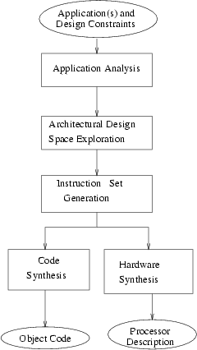
Flow Diagram of ASIP Design Methodology

Slide 4
Application Parameters
Architectural Features
Sato Application Program Analyzer
- Data Types and their access methods
- Operators and Functions exec. Counts
- Frequency of single/ sequence of instr.

Slide 5
Approaches by Gupta et al and Ghazal et al
Average basic block size
Number of MAC operations
Ratio of address computation instr. to data computation instr.
Ratio of I/O to total instr.
Average cycles generation to consumption of scalar
Number of operation slots in each instruction
Concurrent load/store operations
Latency of FUs and operations
addressing support, instruction packing, memory pack/ unpack support

Slide 6
What is needed ?
Consider more architectural features
Study relationship between application parameters and architectural features

Slide 7
Objectives
Study the effect of change in register file size
Use this to understand the trend for power and performance estimation in general ASIP synthesis framework

Slide 8
Experimental Setup
ARM7TDMI processor
LEON processor
encc Compiler (retargetable energy aware C compiler)
Benchmark Programs

Slide 9
ARM7TDMI Processor
32-bit RISC processor
High performance, low power consumption
Two instruction sets (32-bit ARM set and 16-bit THUMB set)
37 32-bit registers (31 GPRs 6 status)
THUMB mode 8 GPRs available

Slide 10
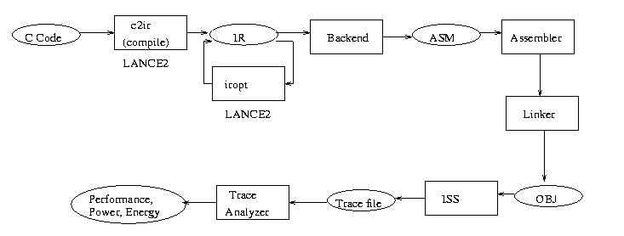
Workflow of encc Compiler

Slide 11
Power Model
Based on Tiwari’s model
Consider processor power and memory power
Based on actual measurements
P_{total} = ∑ P_{proc} + P_{mem}
exec instr

Slide 12
Benchmark Programs
Biquad_N_sections (DSP)
lattice_init (DSP)
matrix-mult
me_ivlin (media application)
bubble_sort
heap_sort
insertion_sort
selection_sort
http://www.cse.iitd.ernet.in/~manoj/research/benchmarks

Slide 13
Results
Range of number of registers 3 to 8
Memory configurations
- only off chip
- on-chip instruction off-chip data
Results collected
- number of instructions executed
- number of cycles
- ratio of spilling instructions (static)
- power consumption
- energy consumption

Slide 14
Assumptions
Processor cycle does not change with number of registers
Power consumption by each instruction does not change significantly with the change in the number of registers

Slide 15
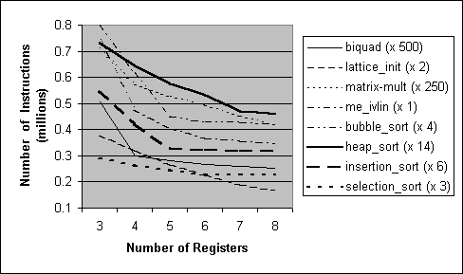
Number of executed instructions

Slide 16
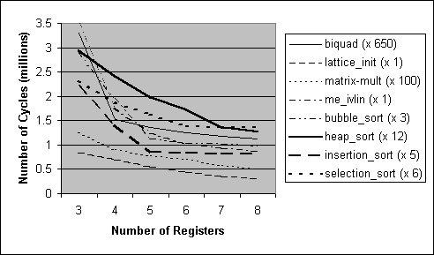
Number of Cycles

Slide 17
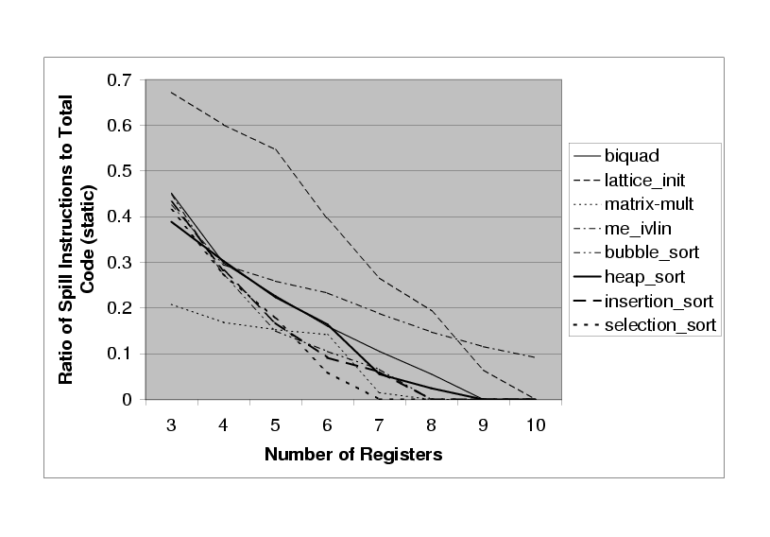
Ratio of spill instructions to total static code size

Slide 18
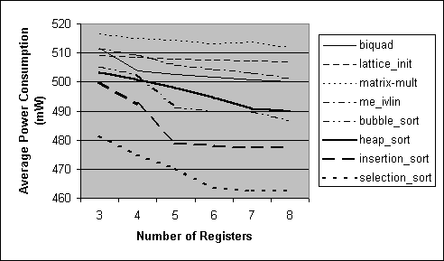
Average power consumption
(off-chip memory)

Slide 19
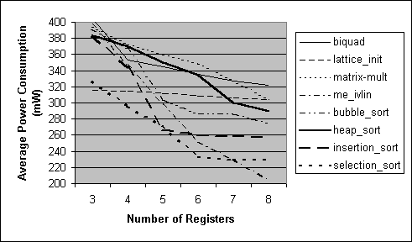
Average power consumption
(on-chip instr. off-chip data)

Slide 20
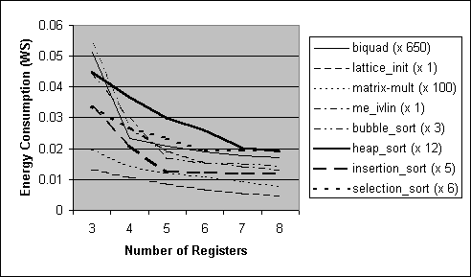
Energy Consumption
(off-chip memory)

Slide 21
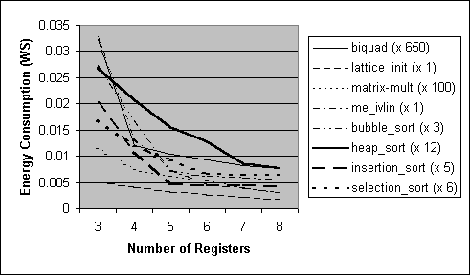
Energy Consumption
(on-chip instr. Off-chip data)

Slide 22
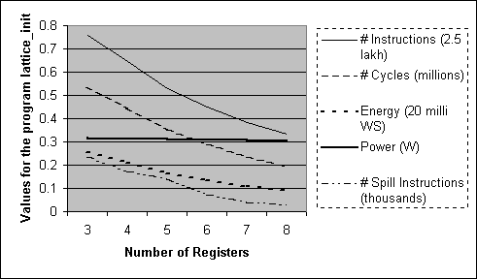
Results for the program lattice_init

Slide 23
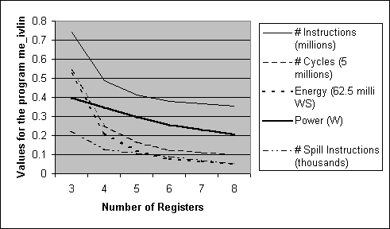
Result for the program me_ivlin

Slide 24
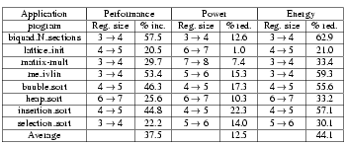
Maximum variation in results

Slide 25
Conclusion
Studied results for number of inst. executed cycles, spilling, power and energy consumption for ARM7TDMI processor. Spilling for LEON.
Range of number of registers 3 to 8.
Single increase in number of registers up to 57.5% performance improvement and 62.9% reduction in energy consumption.
Power does not strongly depend on number of registers

Slide 26
Future work
Identify and extract application parameters to assist early estimation of optimal number of registers.
Consider effect on instruction encoding and instruction bit-width

Slide 27
References
Ghazal, N. et al “Retargetable estimation scheme for DSP architecture selection” ASP-DAC 2000. pp. 485-489.
Gupta T.V.K. et al “Processor evaluation in an embedded system design environment” VLSI 2000. pp. 98-103
http://www.arm.com/
Jain M.K., Balakrishnan M. Anshul Kumar “ASIP Design Methodologies: Survey and Issues” to appear in VLSI 2001.
http://ls12-www.cs.uni-dortmund.de/~leupers/lanceV2/lanceV2.html
Sato J. et al “An integrated design environment for application specific integrated processor” ICCAD 1991. pp. 414-417.
Tiwari V. et al “Power analysis of embedded software” ICCAD 1994. pp. 384-390.

Slide 28
Thanks

